Slide 1


LESP ISSUES ASSOCIATED WITH ADOPTINg BYOD APPROACH
Juweria Ali
Group 32

Slide 2

outline
WHAT IS BYOD?
SOFTWARE OWNERSHIP AND LICENSING; LIMITATIONS AND FINANCIAL IMPLICATIONS OF BYOD
LEGAL REGULATIONS FOR INFORMATION SECURITY
IT POLICIES
1
2
3
4
FOI ACT REQUESTS
CRITICAL INFRASTRUCTURE SECURITY
RECOMMENDATIONS
REFERENCES
5
6
7
8
9
PLAN AND CONTRIBUTIONS

Slide 3



WHAT IS BYOD?
Bring Your Own Device.
The phrase and the "BYOD" acronym is a take-off on "BYOB", a party invitation term first recorded in the 1970s (Wikipedia 2019).
BYOD refers to a policy where employees are permitted to use personal devices to:
Connect to their organizational networks;
Access work-related systems such as emails, and;
Access potentially sensitive or confidential data.

Slide 4




SOFTWARE OWNERSHIP AND LICENSING FOR APPLICATIONS; LIMITATIONS AND FINANCIAL IMPLICATIONS OF BYOD
Potential Software licensing issue.
Licensing policies / procedure should be in place, which define and control how the consumption of licenses will be monitored throughout the organisation.
The organisation’s BYOD software must be installed on staff’s own devices in order for access to be granted to systems. Staff must not remove or modify the BYOD software on their device.
An automated process that ties in with an organisation’s IT service oriented architecture can have the benefit of allowing many tools to work in a more consistent manner in one integrated system.
Pro-active control and having a comprehensive license management environment can help in getting rid of avoidable software spending, reducing a company’s overall software budget.
LIMITATIONS
Lack of Uniformity in Devices
Increased Distraction
Higher Security Risk
Difficult Data Retrieval
Legal Issues
FINANCIAL IMPLICATIONS
Potential Financial Savings.
Staff liable for device cost.
Staff liable for mobile & data cost.
Health liable for software costs

Slide 5


LEGAL REGULATIONS FOR INFORMATION SECURITY
What legal regulations need to be considered for patient confidentiality?
Data Protection Act (DPA) General Data Protection Regulation (GDPR) Access to Health Records Act 1990
Caldicott Principles
Implications & Considerations
Polices need to be considered
Record Management
Information Governance
Data Retention
IT & password security
Subject Access Request
If/how patients should be advised their data will be stored this way
Is a secure method of communication being used
Data Controller Data Protections Impact Assessment (DPIA)
GDPR Principles
Stored Securely
Lawful, fair and transparent
Limited to specific purpose
Accurate
Accountable
Data Minimisation
Storage Limitation
Patient Rights
To be Informed
Rectification
To be Erased
To Restrict processing
Data to Portability
To Access - Subject Access Request
To Object

Slide 6

IT POLICIES
Responsible Use of device Policy​
Hospital staff must be very disciplined in the working environment so as to prevent using their devices for inappropriate things ​
Data classification and handling policy​
In order to protect the integrity of the organization, hospital staff must be very disciplined when using their personal device for the hospital work in a sense that they​
Password management policy​
This simply means supercharging your password or complexing your passwords to prevent easy guessing​
Network access and usage policy​
The hospital first of all should have a private network on its own embedded with firewalls and restrictions ​

Slide 7



FOI ACT REQUESTS
How many cyber-attacks have you had?
The Freedom of Information Act 2000
Members of the public are entitled to request information from public authorities.
Unless there is a good reason for them not to.
Article 17 of the FOI Act (Article 16 of the Scotland Act)
Refusal of an FOI request.
Requests regarding number of security attacks?
Refusal on the basis of:
Article 36 (30 Scotland), Prejudice to effective conduct of public affairs.
Article 31.1.a (35.1.a Scotland), the prevention or detection of crime:
Section 31.—(3) The duty to confirm or deny does not arise if, or to the extent that compliance with section 1(1)(a) would or would be likely to, prejudice any of the matters mentioned in subsection (1).
FACTORS AGAINST CONFIRMING OR DENYING IF WE HOLD RELEVANT INFORMATION
Increase in potential vulnerability and risk of future successful attacks.
Provision of information to malicious parties which may assist in executing a criminal act.
Exposing the organisation’s cyber security arrangements.
Provision of useful confirmation to malicious parties about which of their methods of attack have been successful.

Slide 8


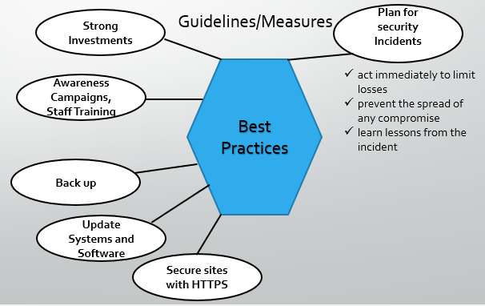
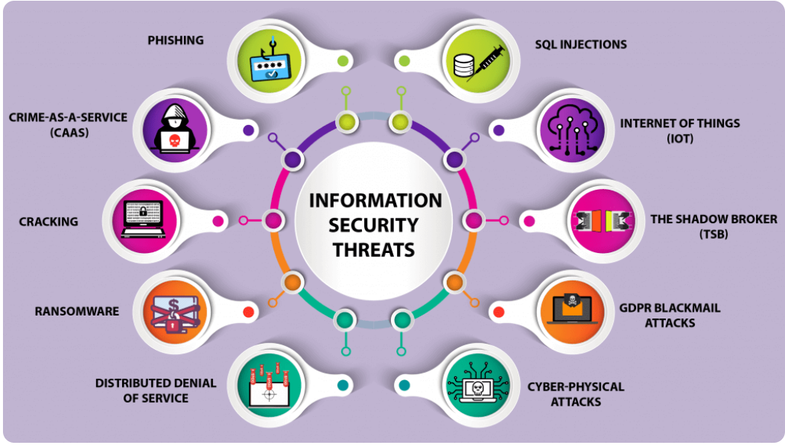
CRITICAL INFRASTRUCTURE And SECURITY MEASURES
Can infrastructure be considered critical ?
The infrastructure will ensure medical professionals can access health documents more efficiently which makes it critical to the health trust
WannaCry Attack -2017
Several organisations, including the NHS
Ransomware - spread through email, internet
Insufficient funding identified as the main reason
Security Threats

Slide 9



RECOMMENDATIONS
Keep passwords secure.
Use biometric features to secure the device if possible.
Keep your operating system updated.
Be careful who can see your screen when accessing work systems.
Report lost or stolen devices.
Help IT to conduct spot checks if required.
Inform IT if you leave employment with the organisation.
Training for staff & contractors.
Designated team responsible for maintaining the security of the system once it is up and running
Data Protection Impact Assessment.
Regular checks of the system to ensure security.
No data stored on device/s.
Policies & procedures updated timely.
Share your device or passwords.
Make copies of data or take screenshots.
Access systems without authorisation.
Save work files in unapproved locations or applications.

Slide 10

REFERENCES
CAMDEN COUNCIL, unknown. Freedom of information requests concerning it security issues, attacks, ransom and malware and related topics. [online]. London Borough of Camden: Camden Council. https://opendata.camden.gov.uk/views/jmi5-3eff/files/f879e933-56ad-4836-924c-62f37e28f725 [Accessed 3 March 2022].
INFORMATION COMMISSIONER’S OFFICE, 2021. Guide to the UK General Data Protection Regulation (UK GDPR). [online]. Cheshire: Information Commissioner’s Office. Available from: https://ico.org.uk/media/for-organisations/guide-to-data-protection/guide-to-the-general-data-protection-regulation-gdpr-1-1.pdf [Accessed 14 March 2022].
INFORMATION COMMISSIONER’S OFFICE, unknown. Bring your own device (BYOD). [online]. Cheshire: Information Commissioner’s Office. Available from: https://ico.org.uk/media/for-organisations/documents/1563/ico_bring_your_own_device_byod_guidance.pdf [Accessed 14 March 2022].
INFORMATION COMMISSIONER’S OFFICE, unknown. Guide to freedom of information. [online]. Cheshire: Information Commissioner’s Office. Available from: https://ico.org.uk/for-organisations/guide-to-freedom-of-information/ [Accessed 3 March 2022].
NHS INFORM, 2021. How the NHS handles your personal health information. [online]. Glasgow: NHS inform. Available from: https://www.nhsinform.scot/care-support-and-rights/health-rights/confidentiality-and-data-protection/how-the-nhs-handles-your-personal-health-information [Accessed 14 March 2022].
SCOTTISH GOVERNMENT, 2020. Records Management: Health and Social Care Code of Practice. [online]. Edinburgh: Scottish Government. Available from: https://www.informationgovernance.scot.nhs.uk/wp-content/uploads/2020/06/SG-HSC-Scotland-Records-Management-Code-of-Practice-2020-v20200602.pdf [Accessed 14 March 2022].
SCOTTISH GOVERNMENT, 2011. NHS Scotland Caldicott Guardians: Principles into Practice. [online]. Edinburgh: Scottish Government. Available from: https://www.gov.scot/publications/nhsscotland-caldicott-guardians-principles-practice/pages/2/ [Accessed 14 March 2022].
UCISA, 2019. UCISA guidance on FOI requests related to cyber security. [online]. Oxford: UCISA. Available from: https://www.ucisa.ac.uk/-/media/Files/UCISA/Publication-files/Directors-cut/FOI-Cyber-security-Directors-cut.pdf [Accessed 3 March 2022].
UK GOVERNMENT, 2020. Guidance The Caldicott Principles. [online]. London: UK Government. Available from: https://www.gov.uk/government/publications/the-caldicott-principles [Accessed 14 March 2022].
UK Government, 2020. BYOD Guidance: Device Security Considerations. [online]. London: UK Government. Available from: https://assets.publishing.service.gov.uk/government/uploads/system/uploads/attachment_data/file/360960/BYOD_Guidance_-_Device_Security_Considerations.pdf [Accessed 3 March 2022].
WIKIPEDIA CONTRIBUTORS, 2022. Bring your own device. [online] Wikipedia, The Free Encyclopedia. Available from: https://en.wikipedia.org/w/index.php?title=Bring_your_own_device&oldid=1070953577 [Accessed 6 March 2022].
UK Government, 2022. [online]. London: UK Government. Available at: https://assets.publishing.service.gov.uk/government/uploads/system/uploads/attachment_data/file/360959/BYOD_Guidance_-_Executive_Summary.pdf [Accessed 8 March 2022].
STEALTHLABS, 2022. Cyber Security Threats and Attacks: All You Need to Know. [online] Available at: https://www.stealthlabs.com/blog/cyber-security-threats-all-you-need-to-know/ [Accessed 8 March 2022].
NHS, 2022. Bring your own device policy. [online] Available at: https://www.nhsx.nhs.uk/key-tools-and-info/procurement-frameworks/clinical-communications-procurement-framework/bring-your-own-device-policy/ [Accessed 8 March 2022].

